Slide 1
J-K Flip-Flop
Joshua Gould
12/5/2018
ECE 09.414 VLSI Design
Dept. of ECE
Henry M. Rowan College of Engineering
Rowan University

Slide 2
Outline
J-K Flip-Flop Overview / Description
Features / Problems
Block Diagram
Truth Table
Master Slave Design
Design Choices
Logical Design
Worst Case Design
Logical Effort, Number of Stages, Delay
Gate Sizes for Optimized Design
Standard Cell Library & Layout Simulations
Conclusion

Slide 3
Overview
JK Flip-Flop with Clear
  like the SR flip-flop, includes a "toggle" function when inputs are set to 1.
  Outputs only change with a clock pulse (Synchronous)
J (set) and K (reset)
  In other words:
  J=1, K=0 sets the flip-flop
  J=0, K=1 resets the flip-flop
  J=1, K=1 toggles the flip-flop

Slide 4
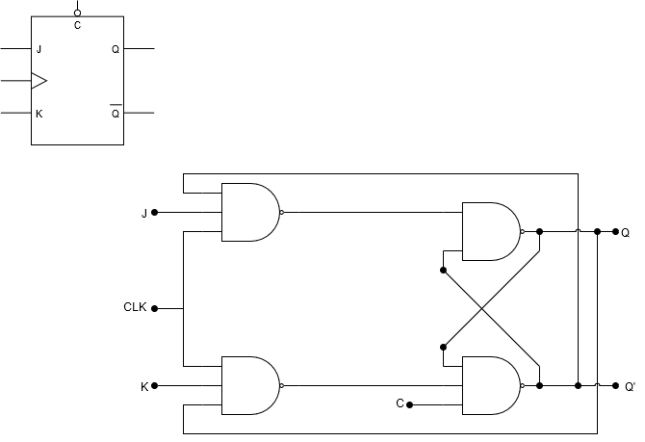
Block Diagram

Slide 5

Truth Table
Inputs |  |  |  | Outputs |  | Action
J | K | CLK | CLR | Q | Q’
0 | 0 | Edge | 0 | Last Q | Last Q’ | Retain State
0 | 1 | Edge | 0 | 0 | 1 | Reset Q
1 | 0 | Edge | 0 | 1 | 0 | Set Q
1 | 1 | Edge | 0 | Last QN | Last Q | Toggle
0 or 1 | 0 or 1 | 0 or 1 | 1 | 0 | 1 | Asynchronously Reset Q
0 or 1 | 0 or 1 | 0 or 1 | 1 | Last Q | Last QN | Illegal State

Slide 6
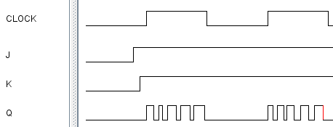
JK Flip-Flop Issues
Uncontrolled toggling when clock is high
Minimized features

Slide 7
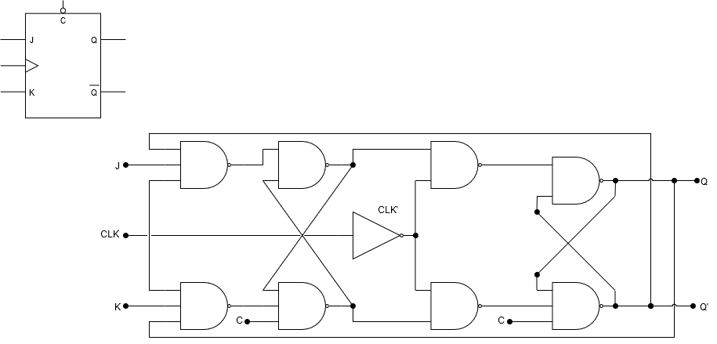
Master/Slave Flip-Flop
Master Latch
Slave Latch
Two latch stages in a cascaded configuration
Activated with opposite clock phases
Eliminates uncontrolled oscillations since only one stage is active at any given time

Slide 8
Master/Slave Flip-Flop
Master Latch
Slave Latch
Single flip-flops suffer from “race” timing problems
Race timing occurs if the output Q changes state before the timing pulse of the clock input has time to go “OFF”.

Slide 9
Design Overview
POSSIBILITY 1: NAND Logic Gate
  PROS:
    Simple design
    Smallest design area
    Uses simple gates
  CONS:
    Notable output timing errors
    Minimized features
    Limited in pulse width for the clock and inputs

Slide 10
Design Overview
POSSIBILITY 2: Master-Slave NAND Logic Gate
  PROS:
    Simple design doubled
    Fixes race error
  CONS:
    Uneven design with clear
    Large amount of transistors
    Minimized features (no PRESET)
    Some constraints on the clock pulse width
    Delay on Slave latch (1/2 clock period)

Slide 11
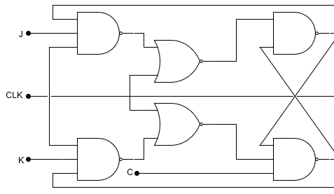
Design Overview
POSSIBILITY 3: NOR based JK Flip-Flop
  PROS:
    Fixes the SR Latch with the 3
    input NANDs so all inputs are
    allowed.
  CONS:
    Inputs must be stable for
    some time before clock goes low.
    The output will oscillate continuously until the or one of the input signals goes low
    Larger design area than NAND only (+2 NOR +2 NOT)
    Highest number of transistors required

Slide 12
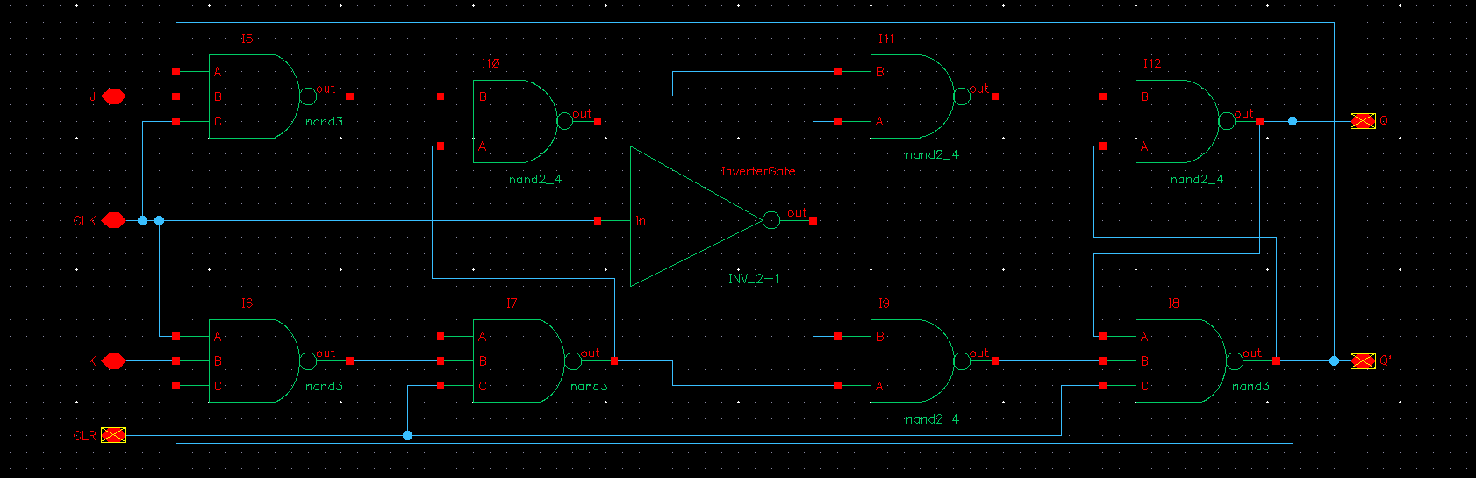
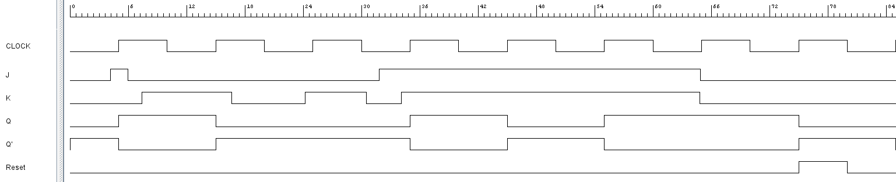
Logic Design

Slide 13
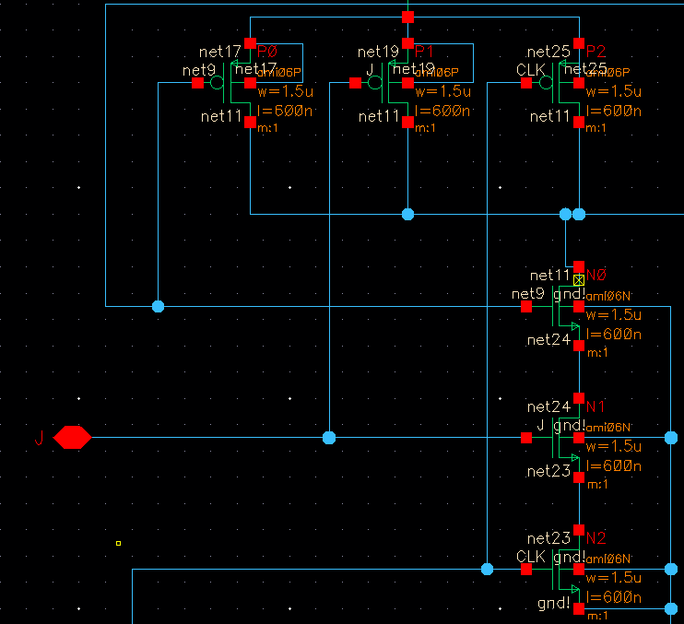
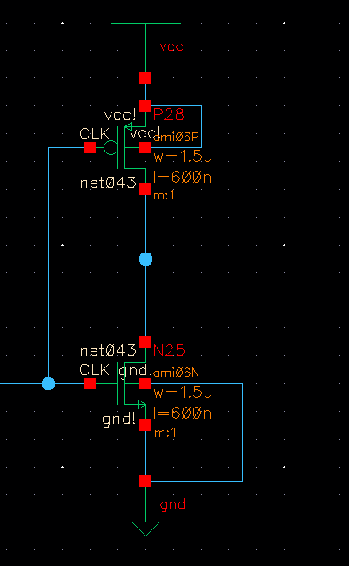
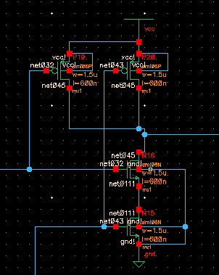
Transistor Design

Slide 14
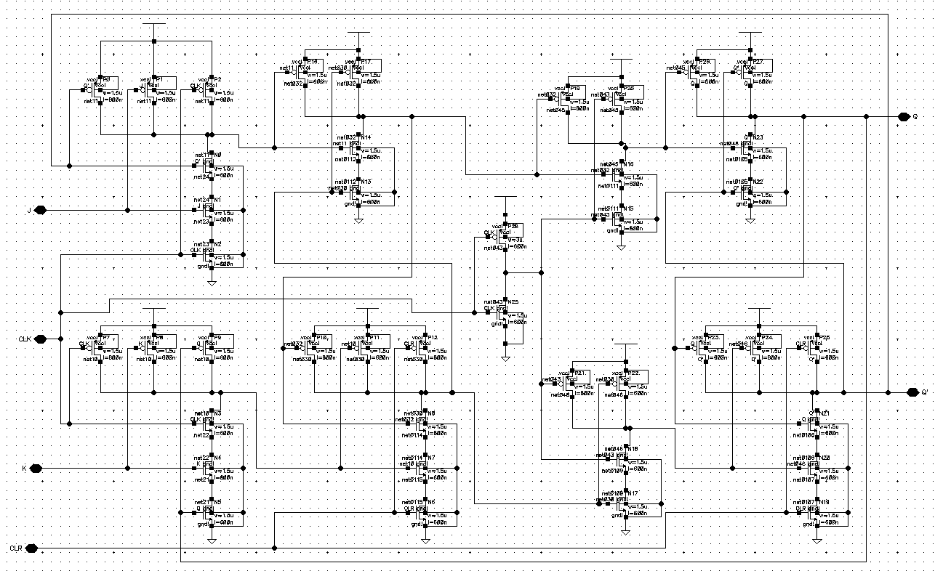
Transistor Design

Slide 15
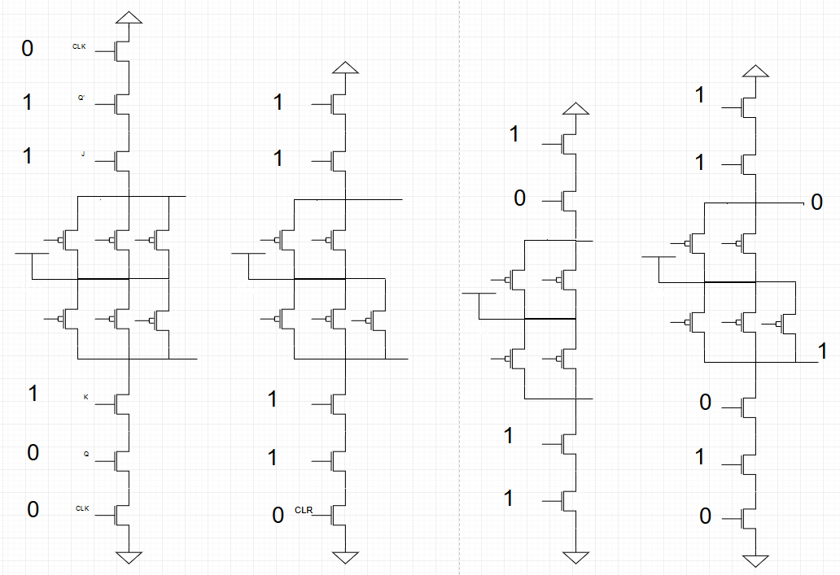
Worst Case Logical Path
J
Q’
CLK
CLK
Q
K

Slide 16
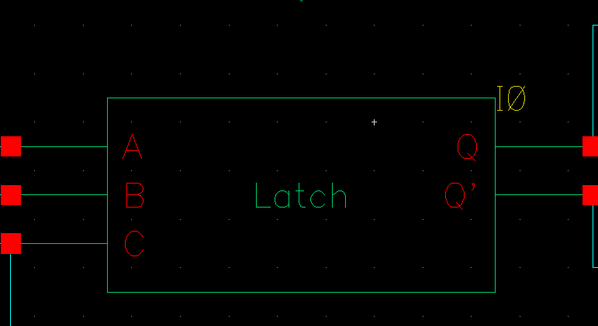
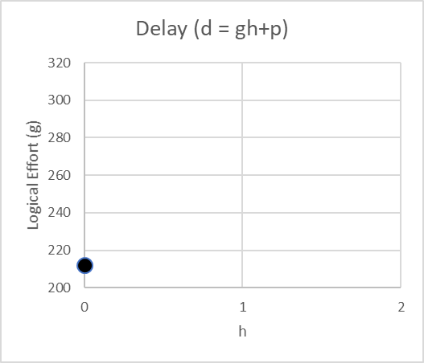
Latch Delay Calculation
The logical effort of the flip-flop must be characterized in Cadence due to the feedback path on each latch.
Use d = gh + p to find latch parameters

Slide 17
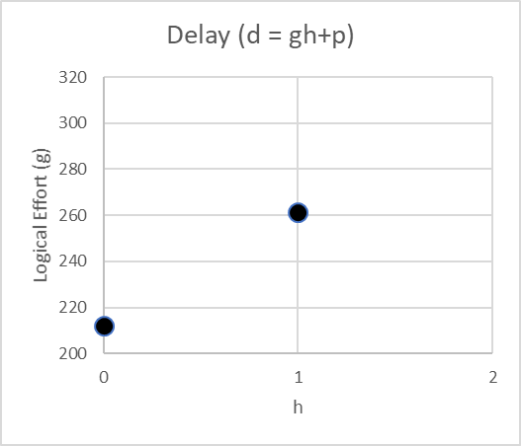
Latch Delay Calculation
The logical effort of the flip-flop must be characterized in Cadence due to the feedback path on each latch.
Use d = gh + p to find latch parameters

Slide 18
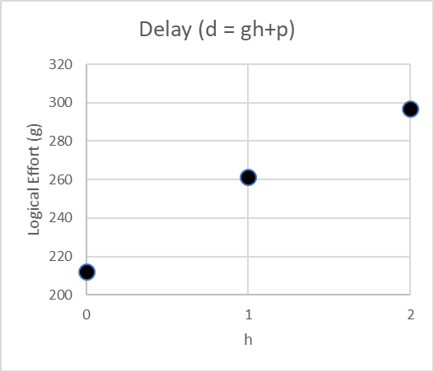
Latch Delay Calculation
The logical effort of the flip-flop must be characterized in Cadence due to the feedback path on each latch.
Use d = gh + p to find latch parameters

Slide 19
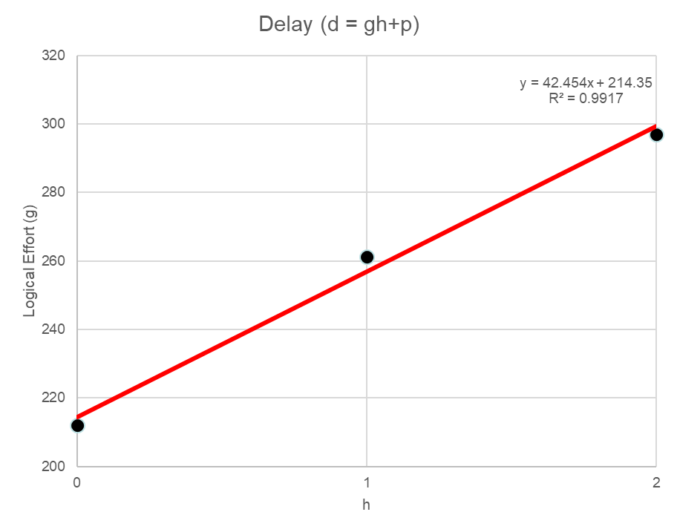
Latch Delay Calculation
h | g
0 | 212.105
1 | 261.3
2 | 297.012
d = gh+p
= 42.45h + 214.35
= 256.804 at h = 2

Slide 20
Effective Latch Stages

Slide 21
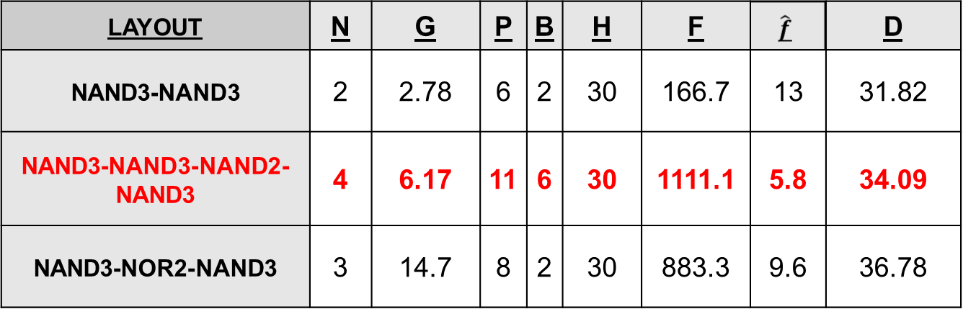
Spreadsheet Comparing Combinational Designs

Slide 22
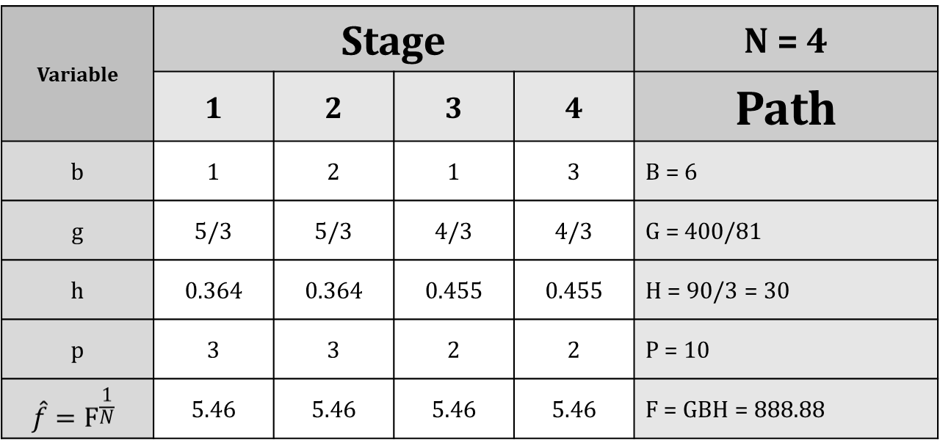
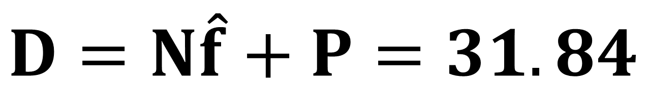
Logical Effort, Number of Stages, Delay

Slide 23
Gate Sizes for Optimized Design

Slide 24
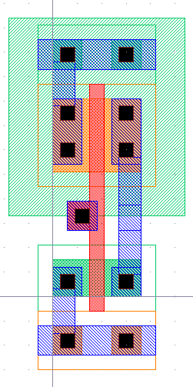
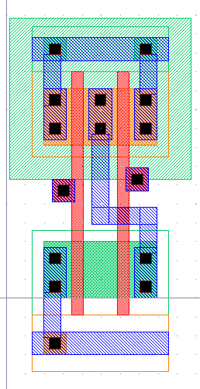
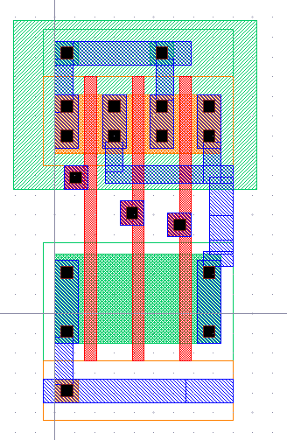
Standard Cell Library

Slide 25
Standard Cell Library Layouts

Slide 26
Standard Cell Library Extracted Layouts

Slide 27
Standard Cell Library Simulation
“Spectre” Netlist

Slide 28
Standard Cell Library Simulation
Input / Output Waveforms

Slide 29
Snap-together Standard Cells
Circuit Layout

Slide 30
Snap-together Standard Cells Simulation
Input / Output Waveform

Slide 31
Delay Comparison
Logical Effort vs. Spectre

Slide 32
Conclusions

